Slide 1

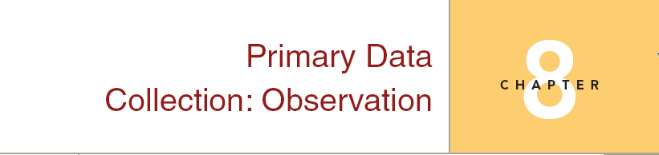
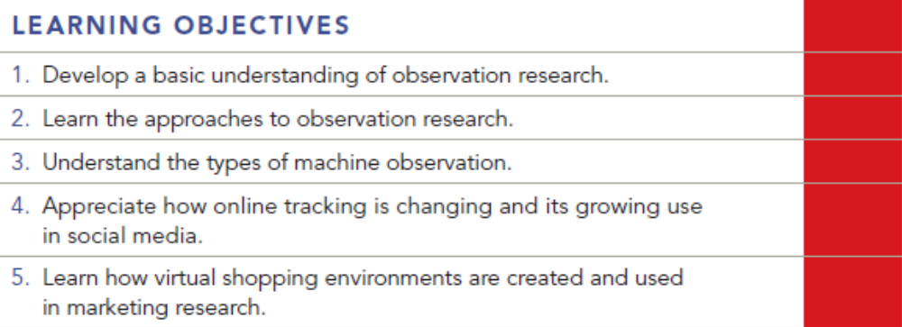
Chapter Eight
8-1

Slide 2
Question
Target Stores is evaluating several locations for locating a new Super-Target Super-Center. To do this, a traffic counting machine records the number of cars passing each location every day of the week for a 3-month period. This is an example of which kind of observation situation?
a. people watching people
b. people watching phenomena
c. machines watching people
d. machines watching phenomena
e. none of these

Slide 3
Answer
Ans: D

Slide 4
Question
Observing consumers’ behavior through a one way mirror is a common type of _______.
open observation
disguised observation
structured observation
unstructured observation

Slide 5
Answer
Ans: B

Slide 6
Question
Which type of research is most closely associated with human observation?
qualitative
quantitative
ethnographic
mixed methods

Slide 7
Answer
Ans: C

Slide 8
Question
Observational research is most effective if the observed behavior occurs _______.
intermittently
infrequently
rationally
frequently
none of these

Slide 9
Answer
Ans: D

Slide 10
Question
The customer service department of a large department store recently received a complaint about a store associate. The store associate’s manager has been unable to detect any problems with the associate’s performance. Then the service department received another complaint concerning the same associate. Which of the following would be the best approach to investigate the situation?
depth interview with associate
mystery shoppers
depth interview with customers
close observation by the department manager
one-way mirror observations

Slide 11
Answer
Ans: B

Slide 12
Question
Eye tracking devices cannot document which of the following?
Visibility
Engagement
Viewing patterns
Communication hierarchy
All of these can be documented

Slide 13
Answer
Ans: E

Slide 14
Question
Tracking helps answer which of the following questions?
“where?”
“how much?”
“how often?”
all of these
none of these

Slide 15
Answer
Ans: D

Slide 16
Question
Fisher-Price has asked you to develop a research procedure for determining which of its prototype toys is most appealing for 4- and 5-year-olds. Suggest a methodology for making this determination.

Slide 17
Answer
Put three or four children in a room with the toys. Observe them from behind a one-way mirror. Count the number of times a child goes back to a toy or the length of time the children play with each one. Since children’s’ attention spans can be brief, those toys which are played with for the longest period of time might be the most appealing. Also, carefully note the role of group dynamics. Children are naively egocentric. They may want a toy simply because another child wants it. If this is perceived to be a problem, the group of children may need to be narrowed to one child at a time in the playroom. Another way to deal with the “mine” problem is to have duplicates or even triplicates of the toys.

Slide 18
Question
What are the biggest drawbacks of observation research?

Slide 19
Answer
One disadvantage of observation research is that only behavior and physical characteristics can be examined. Also, only public behavior is observed. A researcher cannot determine how many products are used or why they are used that way. Observed behavior may not be projectable to the future. Just because a consumer makes a purchase or a decision today does not guarantee that he or she will do the same tomorrow. Finally, observation research can be time-consuming and costly if the observed behavior occurs rather infrequently.

Slide 20
Question
It has been said that “people buy things not for what they will do, but for what they mean.” Discuss this statement in relation to observation research.

Slide 21
Answer
People often buy objects for social status, prestige, for what others think about their purchases, and what it does for their self-concept. If we assume this hypothesis to be correct, then observational research may be less useful because it produces data regarding external events rather than internal motivations. Observation research could, however, be used in an attempt to measure the effect of physiological arousal on product purchase, thereby providing a crude measure of motives via internal psychological or emotional states.

